Slide 1

Input-output Interface
Computer Organization and Architecture | Memory & I/O Organization
Course: Computer Organization and Architecture | Chapter: Memory & I/O Organization | Program: Bachelor of Engineering
DISCOVER · LEARN · EMPOWER
Notes:
Welcome everyone to today's lecture on the Input-output Interface. This session is a critical part of our Memory and I/O Organization chapter. As we explore how the CPU communicates with external devices, remember that this interface is the bridge between the fast processor and the slow peripherals. Let us begin by understanding the fundamental need for these interfaces.

Slide 2
Course Outcomes
SLIDE 2 / 10
Course Outcome
CO | BT LEVEL | DESCRIPTION
CO1 | BT3 | Apply number systems and digital logic to design basic digital circuits
CO2 | BT4 | Analyze register organization and instruction set architecture
CO3 | BT3 | Implement computer arithmetic algorithms and floating-point operations
CO4 | BT5 | Analyze memory hierarchy and input-output organization
CO5 | BT6 | Evaluate control unit design and pipelining performance
Chandigarh University
2 / 10
Notes:
Today's lecture is directly mapped to Course Outcome 4, which requires you to analyze memory hierarchy and input-output organization. We will focus specifically on the mechanisms that allow the CPU to coordinate with various I/O devices. By the end of this session, you should be able to evaluate different interface methods and their impact on system performance. This analysis is crucial for designing efficient computer systems.

Slide 3
Learning Objectives
SLIDE 3 / 10
Learning Outcomes
1
Evaluate the necessity of I/O interfaces for speed mismatch resolution
2
Analyze the functional components of a standard I/O interface module
3
Differentiate between programmed I/O and interrupt-driven I/O methods
4
Assess the role of DMA in high-speed data transfer operations
5
Compare the efficiency of various I/O interface techniques in real scenarios
Chandigarh University
3 / 10
Notes:
By the end of this lecture, you will be able to evaluate why interfaces are needed to resolve speed mismatches between the CPU and peripherals. You will analyze the functional components like data registers and control logic that make communication possible. We will differentiate between programmed I/O and interrupt-driven methods to understand their trade-offs. Finally, you will assess the role of DMA in handling high-speed data transfers efficiently.

Slide 4
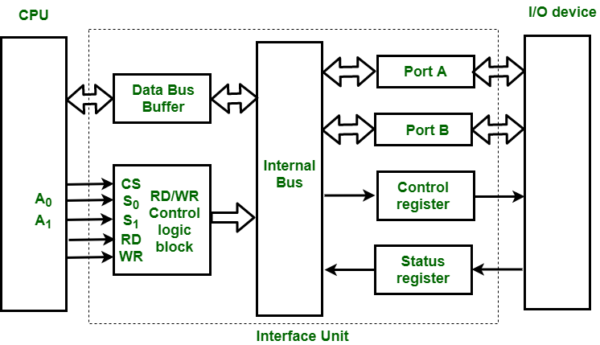
Lecture
SLIDE 4 / 10
Need for I/O Interface
1
CPU operates at nanosecond speeds while I/O devices operate at millisecond speeds
2
Interfaces provide data buffering to handle asynchronous data transfer rates
3
Logic circuits translate CPU signals into device-specific control commands
4
State registers track the status of the I/O device for the CPU
5
Error detection logic ensures data integrity during transmission between units
I/O Interface (Interrupt and DMA Mode) - GeeksforGeeks
Chandigarh University
4 / 10
Notes:
The primary reason for an I/O interface is the vast speed difference between the processor and peripherals. Imagine a Ferrari trying to drive on a dirt road; the interface acts as the suspension system. It buffers data so the CPU does not wait for a slow printer to finish printing a page. Without this interface, the CPU would be idle for most of its operational time.

Slide 5
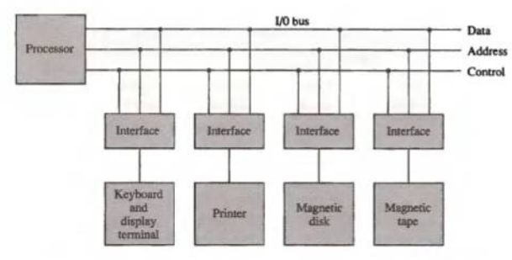
Lecture
SLIDE 5 / 10
Functional Components
1
Data registers store information temporarily during transfer between CPU and device
2
Status registers indicate device readiness, error conditions, and completion flags
3
Control registers accept commands from the CPU to initiate specific operations
4
Address decoders select the specific I/O device or register being accessed
5
Control logic coordinates the timing and sequencing of data transfer signals
I/O Interface in Computer Architecture - VCMOS (source: vcmos.com)
Chandigarh University
5 / 10
Notes:
An I/O interface typically consists of three main types of registers: data, status, and control. The data register holds the byte being transferred, while the status register tells the CPU if the device is ready. The control register accepts commands like 'read' or 'write' from the processor. Address decoders ensure that the CPU talks to the correct device among many connected peripherals.

Slide 6
Lecture
SLIDE 6 / 10
Programmed I/O Method
1
CPU executes a loop to continuously check the status register for device readiness
2
Data transfer occurs only when the status bit indicates the device is ready
3
This method wastes CPU cycles as the processor waits idly for the device
4
Simple to implement but highly inefficient for high-speed or multiple devices
5
Suitable only for very slow devices where waiting time is negligible
I/O Interface (Interrupt and DMA Mode) - GeeksforGeeks (source: media.geeksforgeeks.org)
Chandigarh University
6 / 10
Notes:
In Programmed I/O, the CPU constantly polls the status register to see if the device is ready. This is like a chef constantly checking a slow oven to see if the cake is done. The CPU wastes valuable processing time waiting for the status bit to change. While simple to implement, this method is inefficient because the processor cannot perform other tasks during the wait.

Slide 7
Lecture
SLIDE 7 / 10
Interrupt-Driven I/O
1
CPU initiates transfer and proceeds to execute other instructions immediately
2
Device sends an interrupt signal to the CPU when data is ready
3
CPU suspends current task, saves state, and executes an Interrupt Service Routine
4
Data transfer occurs only after the CPU responds to the interrupt request
5
Significantly improves CPU utilization compared to programmed I/O methods
I/O Interface (Interrupt and DMA Mode) - GeeksforGeeks (source: media.geeksforgeeks.org)
Chandigarh University
7 / 10
Notes:
Interrupt-driven I/O allows the CPU to perform other tasks while waiting for the I/O device. When the device is ready, it sends an interrupt signal to the processor. The CPU then pauses its current work, saves its state, and runs a specific routine to handle the data. This approach drastically improves system efficiency by eliminating the idle waiting time seen in programmed I/O.

Slide 8
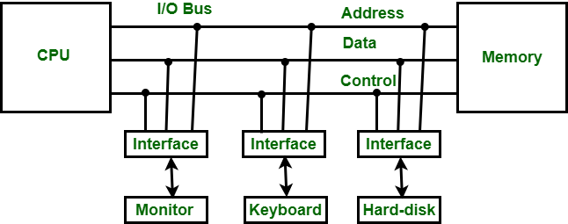
Lecture
SLIDE 8 / 10
DMA Transfer Example
EXAMPLE
Transferring 1000 bytes takes 1000 cycles without DMA vs 1 cycle with DMA
• DMA controller takes over the bus to transfer blocks of data directly
• CPU is free to execute other programs during the entire data transfer process
• DMA transfers data in blocks, reducing the number of interrupt requests needed
• Ideal for high-speed devices like disk drives and network interfaces
Introduction to Input-Output Interface - GeeksforGeeks (source: media.geeksforgeeks.org)
Chandigarh University
8 / 10
Notes:
Direct Memory Access allows a specialized controller to move data directly between memory and the device. Consider transferring 1000 bytes: without DMA, the CPU handles each byte, taking 1000 cycles. With DMA, the CPU initiates the transfer and returns to other tasks, taking only 1 cycle for the setup. This makes DMA essential for high-speed devices where CPU overhead would be unacceptable.

Slide 9
Lecture
SLIDE 9 / 10
Key Takeaways
1
I/O interfaces resolve speed mismatches and provide necessary signal translation
2
Programmed I/O wastes CPU time by polling, while interrupts improve efficiency
3
DMA allows high-speed data transfer without CPU intervention for each byte
4
Status and control registers are critical for managing device communication
5
Choosing the right interface method depends on device speed and system requirements
I/O Interface in Computer Architecture - VCMOS (source: vcmos.com)
Chandigarh University
9 / 10
Notes:
To summarize, I/O interfaces are essential for bridging the speed gap between the CPU and peripherals. We learned that while programmed I/O is simple, it wastes CPU cycles, whereas interrupts allow the processor to multitask. DMA is the most efficient method for large data blocks, freeing the CPU completely. Understanding these distinctions is key to analyzing and designing effective computer systems.

Slide 10
Lecture
SLIDE 10 / 10
References
COMPUTER ORGANIZATION AND DESIGN
The Hardware/Software Interface — David A. Patterson, John L. Hennessy
COMPUTER ARCHITECTURE
A Quantitative Approach — John L. Hennessy, David A. Patterson
• Computer Organization and Architecture — William Stallings
• Computer System Architecture — M. Morris Mano & Rajib Mall
• Computer Organization — Carl Hamacher, Zvonko Vranesic, Safwat Zaky
Chandigarh University
10 / 10
Notes:
For further reading and deeper understanding of these concepts, please refer to the standard textbooks listed here. William Stallings and M. Morris Mano provide excellent foundational knowledge on computer organization. The works by Patterson and Hennessy offer a quantitative approach to understanding these architectural decisions. I encourage you to review these resources to solidify your grasp of I/O organization.

